Slide 1
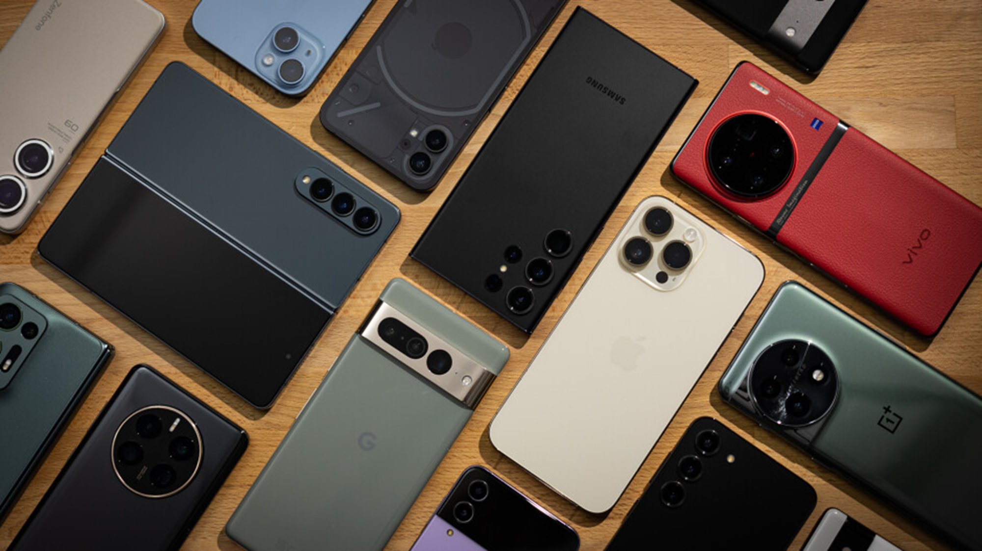
MOBILE PRICE SEGMENTATION
-Vipul Purohit

Slide 2
TABLE OF CONTENT
Description
Project Key Points
-Problem Statement
-Objective
-Variable Description
Model Building
Evaluation Matrix Table
Auto ML model using Pycaret
Conclusion

Slide 3
DESCRIPTION
In a rapidly evolving mobile phone market, understanding the preferences and behaviours of consumers is crucial for manufacturers, retailers, and service providers. A key challenge is to efficiently segment mobile phones into distinct price categories based on their features and specifications, enabling businesses to target specific customer segments effectively and optimize their offerings. This project aims to develop a machine learning solution that automates the process of segmenting mobile phones into different price ranges, enhancing market insights and strategic decision-making.

Slide 4
PROJECT KEY POINTS
Problem Statement :
This project aims to address this issue by developing a machine learning solution for classifying mobile phone prices based on their specifications and features
Objective:
The objective of this project is to create a machine learning model that can accurately segment a collection of mobile phones into meaningful price categories based on their unique attributes. By achieving this, the project seeks to provide valuable insights for market stakeholders and facilitate informed business strategies.

Slide 5
Variable Description
COLUMNS | DESCRIPTION
battery_power | Total energy a battery can store in one time measured in mAh
blue | Has bluetooth or not
clock_speed | speed at which microprocessor executes instructions
dual_sim | Has dual sim support or not
fc | Front Camera mega pixels
four_g | Has 4G or not
Int_memory | Internal Memory in Gigabytes

Slide 6
COLUMNS | DESCRIPTION
m_dep | Mobile Depth in cm
mobile_wt | Weight of mobile phone
n_cores | Number of cores of processor
pc | Primary Camera mega pixels
px_height | Pixel Resolution Height
px_width | Pixel Resolution Width
ram | Random Access Memory in Megabytes

Slide 7
COLUMNS | DESCRIPTION
sc_h | Screen Height of mobile in cm
sc_w | Screen Width of mobile in cm
talk_time | longest time that a single battery charge will last when you are
three_g | Has 3G or not
touch_screen | Has touch screen or not
wifi | Has wifi or not
price_range | Price segments(0,1,2)-Low, Medium, High

Slide 8
MODEL BUILDING
1
Define The Problem
2
Gather & Prepare Data
Gather Relevant Data & Clean the data – Handling missing values, Remove duplicates & Outliers
3
Exploratory Data Analysis (EDA)
Analyse the data to gain insights into its distribution, relationships, and patterns.
Goal of your project & What are you try to predict or Classify
Feature Scaling
Normalization/ Standardization the data & Transform Distribution of data
4

Slide 9
5
6
Model Selection
7
Model Training
Train the selected model on the training dataset using appropriate algorithm.
Data Splitting
Define X, Y variable. Divide the dataset into training, validation, and testing sets
Choose an appropriate machine learning algorithm or model architecture based on the nature of the problem(Regression/ Classification)
8
Model Evaluation
9
Model Tuning
Fine-tune the model by adjusting hyperparameters using Grid Search CV, Randomized search CV
10
Model Interpretation
Try to interpret its predictions to gain insights into the underlying patterns and decision-making process..
Evaluate the trained model's performance on the testing dataset using suitable evaluation metrics (accuracy, precision, recall, F1-score, etc.)

Slide 10
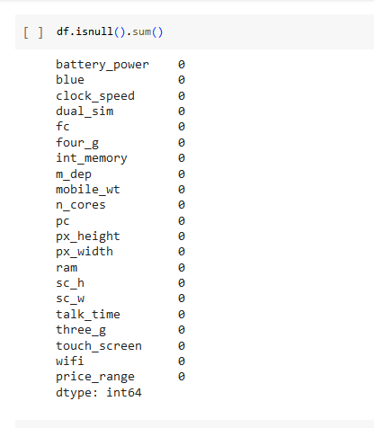
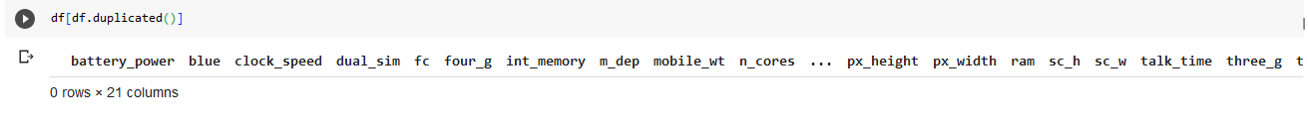
DATA PREPROCESSING
To Check Null Value & Duplicates in Dataset
Data Preprocessing consist of Data Cleaning-Handling Missing Values, Removing duplicates, Detection & Removing Outliers

Slide 11
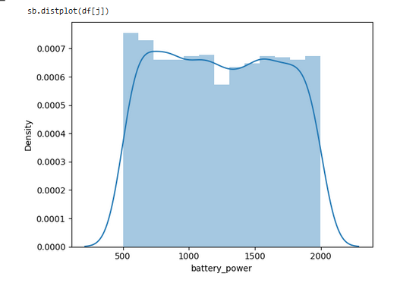
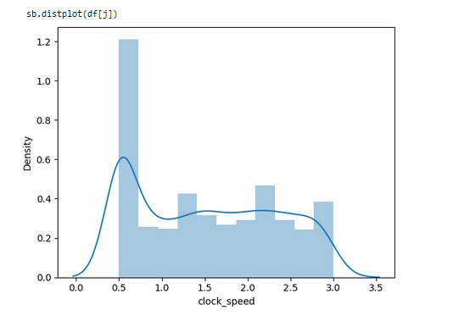
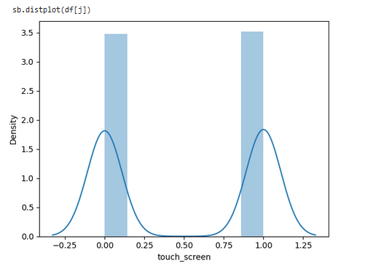
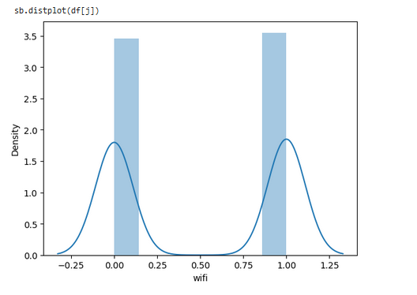
Distribution Of Features

Slide 12
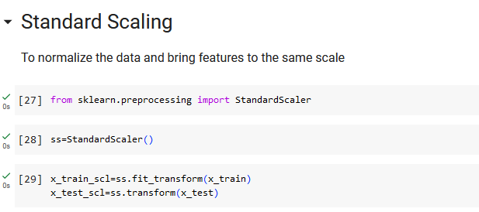
Feature Scaling Standardization scaling is a data pre-processing technique used in statistics and machine learning to transform numerical features by subtracting the mean and dividing by the standard deviation where mean = 0 & Standard Deviation = 1

Slide 13
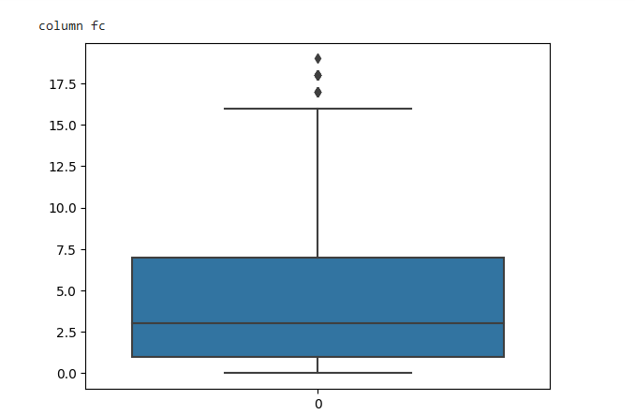
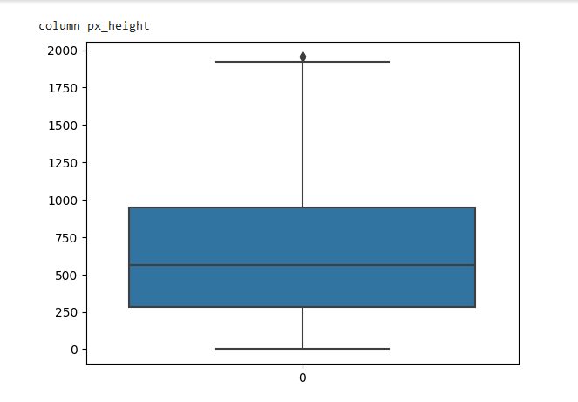
Detecting Outliers

Slide 14
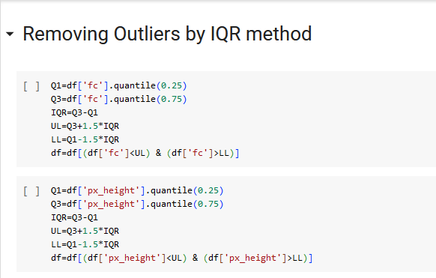
Removing Outliers By IQR Method

Slide 15
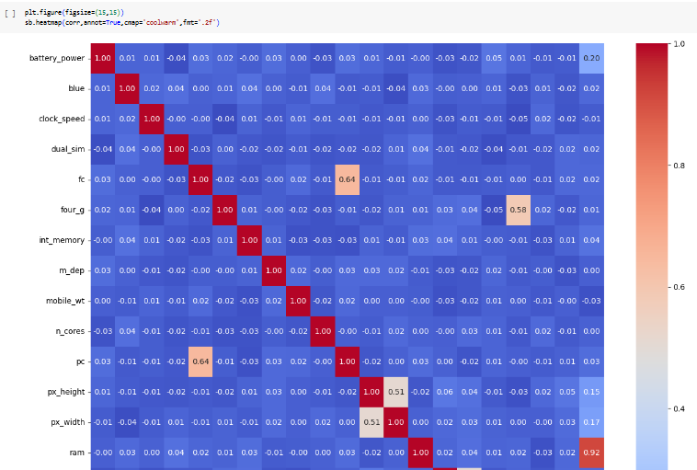
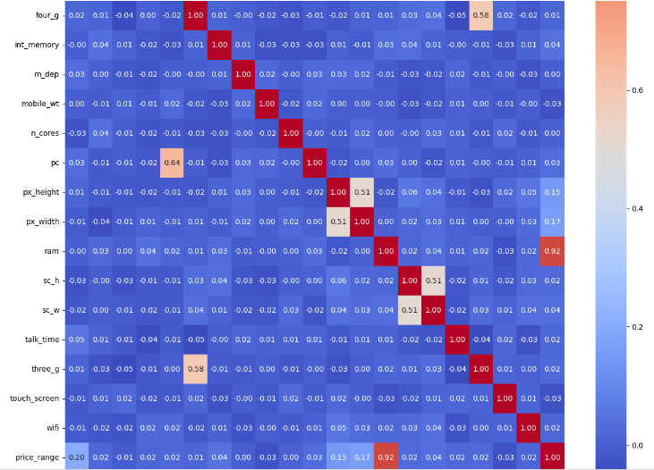
Heatmap Correlation- To check relation with Target Variable

Slide 16
EVALUATION MATRIX TABLE
ALGORITHMS | ACCURACY
Logistic Regression | 96.17%
Neural Network | 95.91%
Gradient Boosting Classifier | 93.62%
Extreme Gradient Boosting | 92.85%
Random Forest Classifier | 92.60%
Decision Tree | 91.59%
Support Vector Machine | 91.58%
K-Nearest Neighbours (Hyperparameter Tuned) | 68.62%
Ada Boost | 68.62%
K-Nearest Neighbours | 58.92%

Slide 17
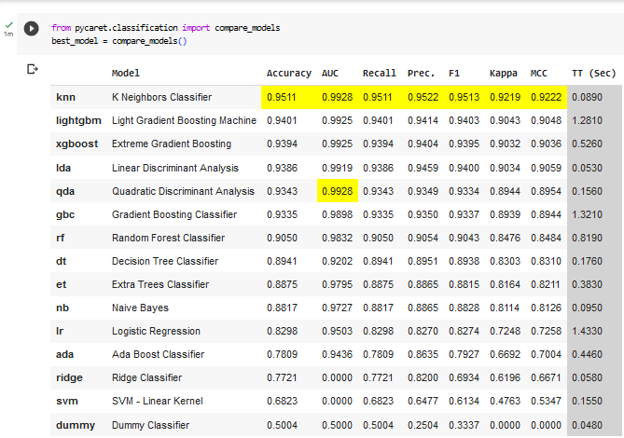
AUTO ML MODEL USING PyCaret
PyCaret automates the entire process of model selection, from data pre-processing to model selection and hyperparameter tuning. This eliminates the need for manual coding and allows users to quickly and easily build and compare models.

Slide 18
CONCLUSION
The successful implementation of this project will result in a reliable mobile price classification system that empowers consumers to make informed decisions when purchasing mobile phones.
By utilizing all classification machine learning algorithms, The algorithms which give me best accuracy are Logistic Regression with 96.17% & Neural Network with 95.91% the model will effectively analyse various specifications and accurately categorize mobile phones into appropriate price ranges, simplifying the decision-making process for consumers.

Slide 19
THANK YOU.

